Slide 1
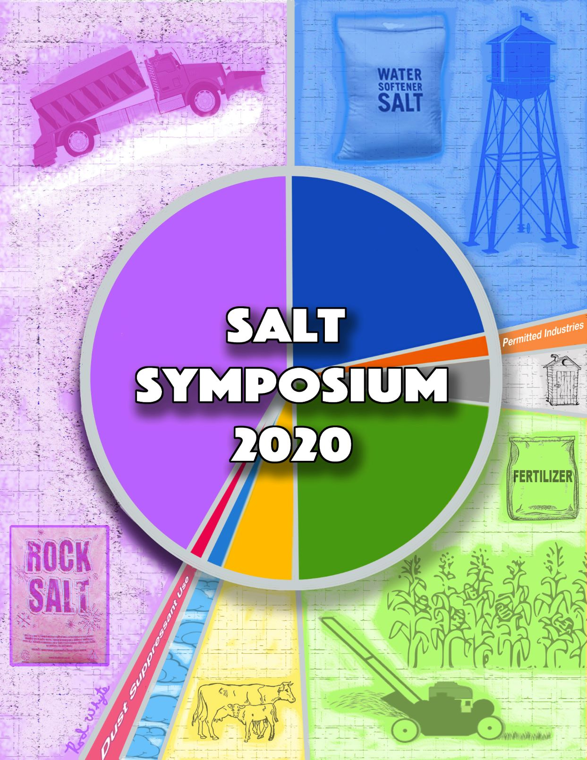
Salt Symposium 2020
Expanded Scope
Road Salts
Water Softeners
Fertilizer
Dust Control
Presented by
Sue Nissen
StopOverSalting
Introducing
Minnesota
Statewide Chloride
Management
Plan

Slide 2
Keynote Speakers
Minnesota's Chloride Sources
Alycia Overbo,
Minnesota Department of Health
Rolling out the Minnesota Chloride Management Plan
Brooke Asleson,
Minnesota Pollution Control Agency

Slide 3
New Directions in Chloride (a.m. session)
Day 1, August 4 - Morning
Chloride and Wastewater Treatment Plants
Scott Kyser & Elise Doucette, Minnesota Pollution Control Agency
Incentivizing Home Water Softener Improvements
Emily Jones, Madison Metro Sewerage District
Process and PR Challenges with Lime/Soda Ash Softening
John Graupman, Bolton and Menck
The Water Softening Industry and Chloride Reduction
Scott Schiesser, Minnesota Water Quality Association

Slide 4
New Directions in Chloride (p.m. session)
Day 1, August 4 - Afternoon
Chloride Moving from Fertilizer through Soil
Aicam Laacouri, Minnesota Department of Agriculture
Is potash application having a negative impact on Minnesota crops?
Daniel Kaiser, University of Minnesota
Simple Steps to Reduce Lawn Fertilizer Use
Carolyn Dindorf, Fortin Consulting
Enhanced Dust Palliatives - Achieve More with Less
Steve Clark, Envirotech Services

Slide 5
Snow & Ice Management
Day 2, August 5
Bringing Smart Salting to a Different Audience: Property Management
Claire Bleser, PhD, Riley Purgatory Bluff Creek Watershed District
Getting the Most out of your Spreader Controls and Truck Telemetry
Andy Kietzmann, Force America, Inc. & Andy Kraemer, Hennepin Co. Highway
How Deicing Chemicals are Changing Landscapes; What Tactics Lessen Damage
Gary Johnson, University of Minnesota
New Liquid Spread Pattern
Jeff Vanderzwaag & Robert Ellis, Iowa Department of Transportation
Perspectives on Lowering Salt Use by Ramping Up Liquids
Jordan Smith, Smith Lawn and Landscaping
Craig Eldred, City of Waconia
Kris Holzknecht, Anoka County Highway Department
Christopher Cheney, Minnesota Department of Transportation

Slide 6
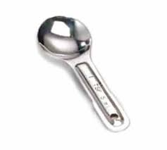
Salt Symposium 2020 (2)
1 teaspoon salt
permanently
pollutes
5 gallons water

